Slide 1
Statistical Analysis and Data Processing on Predicting Student Performance Student Name: Kunga Nyima Gurung Course: GCIS-523-0B: Statistical Computing Instructor: Marwah Obaid University: Gannon University Student ID: 318127501

Slide 2
Introduction
Objective: To analyze and predict the performance of students based on various factors.
Key Features:
Hours Studied
Previous Scores
Extracurricular Activities
Sleep Hours
Sample Question Papers Practiced

Slide 3
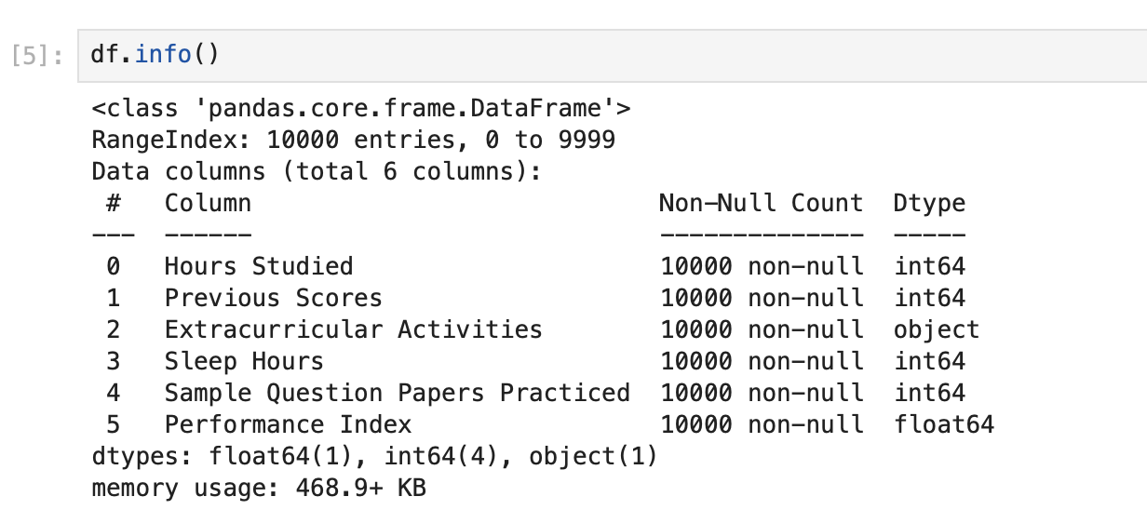
Data Overview
Dataset Information:
Rows: 10,000
Columns: 6
Columns:
Hours Studied, Previous Scores, Extracurricular Activities, Sleep Hours, Sample Question Papers Practiced, Performance Index
Data Type:
4 Numeric (int, float)
1 Categorical (Extracurricular Activities)

Slide 4
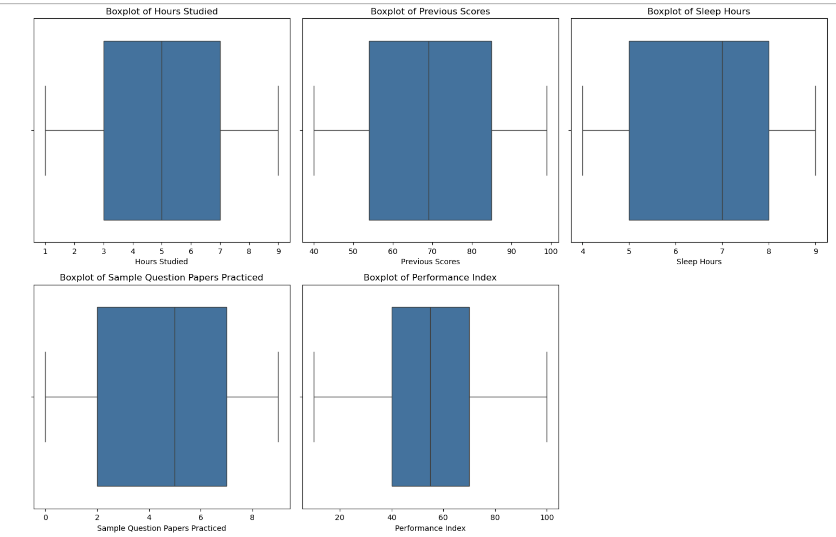
Data Cleaning Process
Missing Values: No missing values in the dataset.
Duplicates: 127 duplicate rows removed (from 10,000 to 9,873 rows).
Outliers: No significant outliers detected (Boxplot and IQR method).

Slide 5
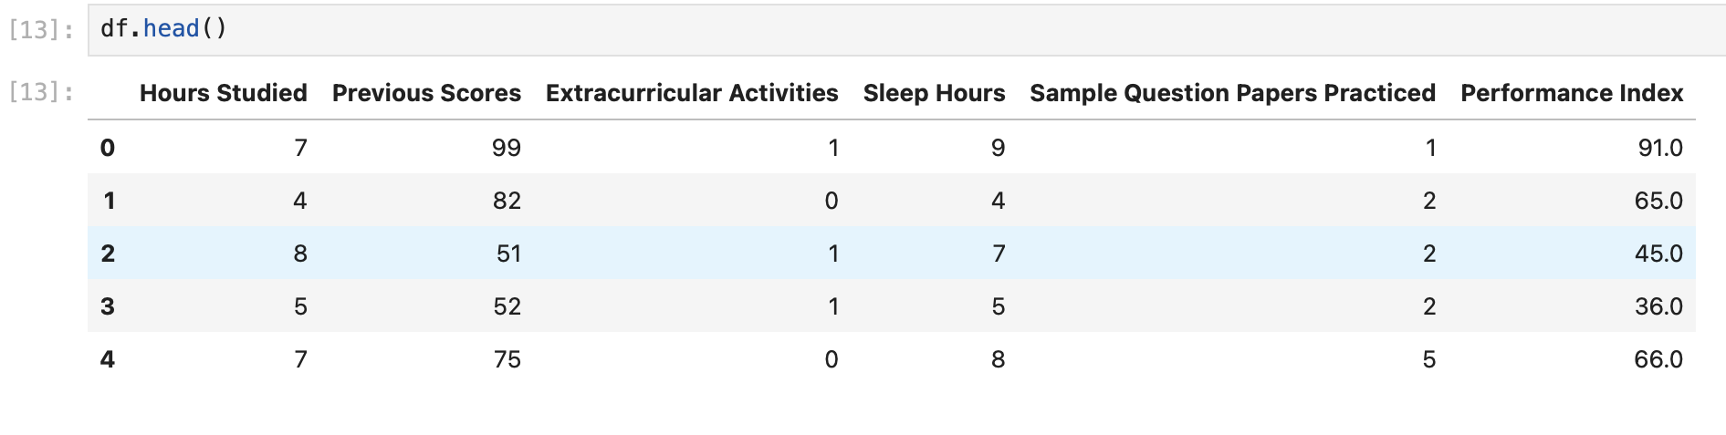
Encoding Categorical Variables
Extracurricular Activities: Categorical data encoded using LabelEncoder for numerical analysis.
Encoded Values:
Yes = 1
No = 0

Slide 6
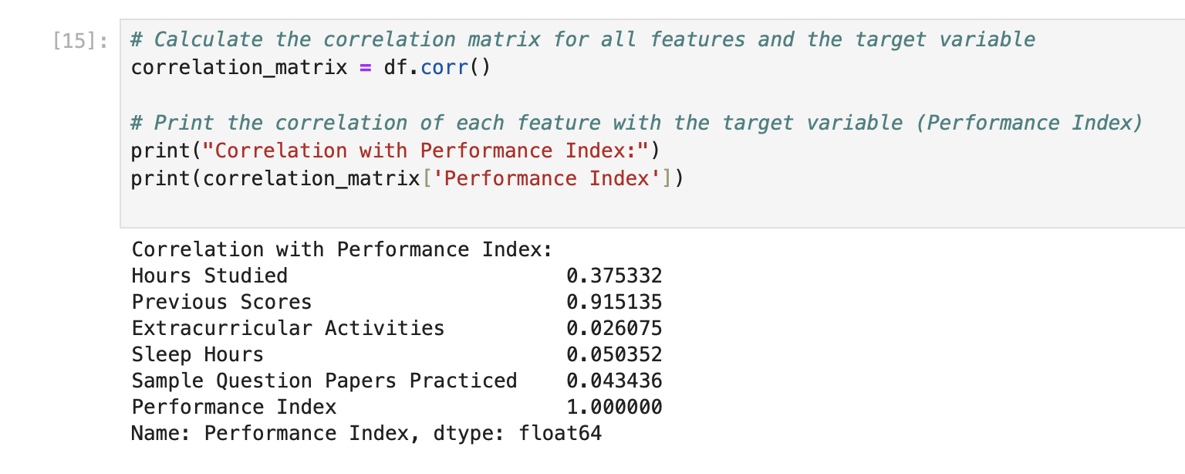
Correlation Analysis
Correlation with Performance Index:
Previous Scores: 0.92 (Strong Positive Correlation)
Hours Studied: 0.38 (Moderate Positive Correlation)
Extracurricular Activities: 0.03 (Very Weak Correlation)
Sleep Hours: 0.05 (Very Weak Correlation)
Sample Question Papers Practiced: 0.04 (Very Weak Correlation)

Slide 7
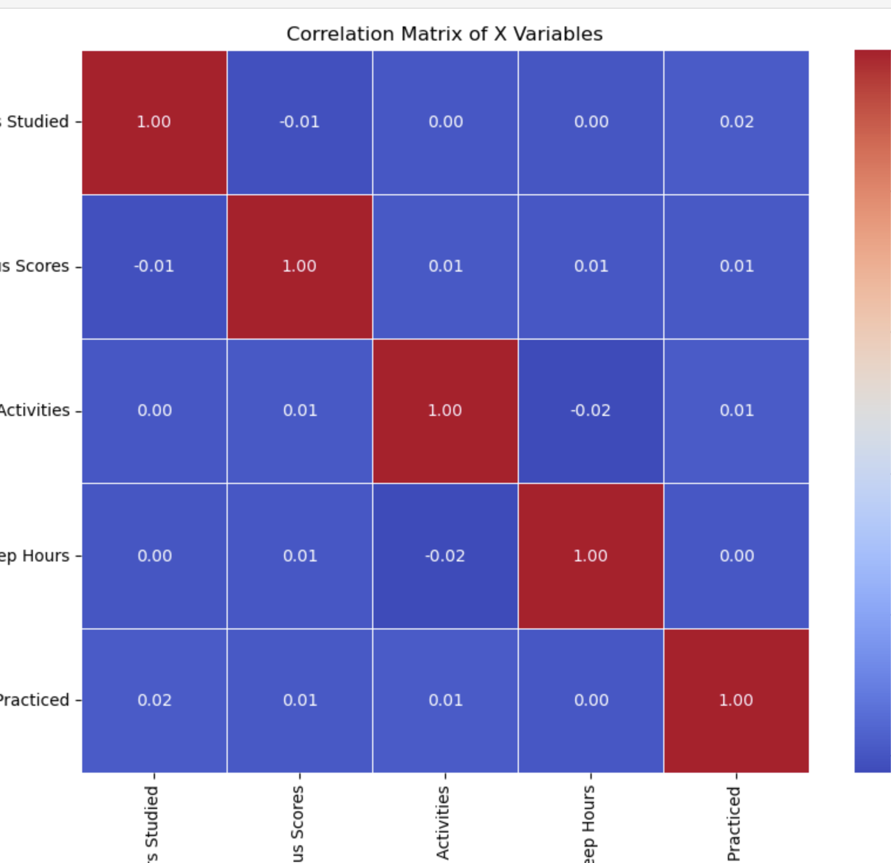
Correlation Matrix Heatmap
Visual representation of correlation between independent variables and target variable (Performance Index).
Key Insights:
Strong correlation between Previous Scores and Performance Index.
Weak correlation with other factors like Sleep Hours and Extracurricular Activities.

Slide 8
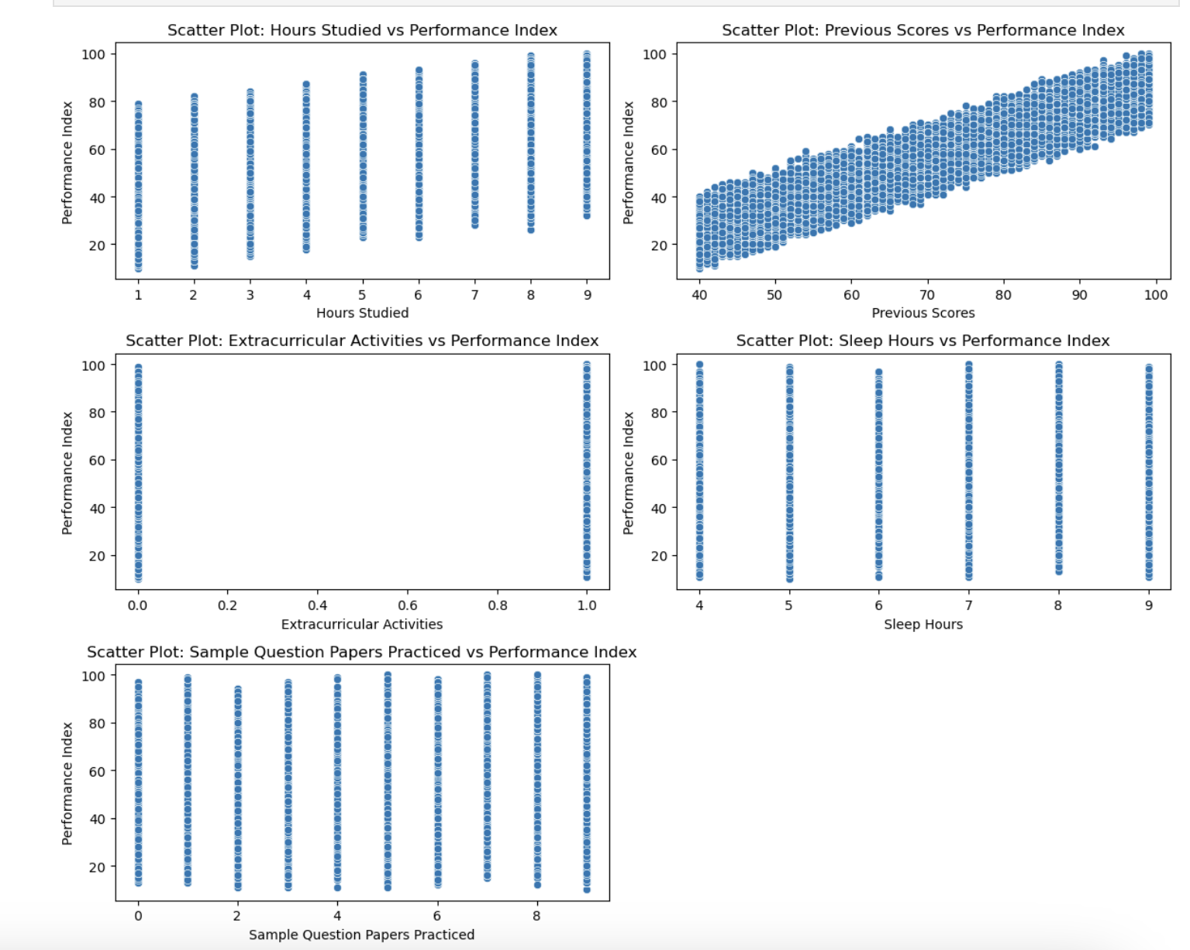
Scatter Plots
Scatter Plots: Visualized relationship between independent variables (Hours Studied, Previous Scores, etc.) and Performance Index.
Highlighted trends show stronger effects for Hours Studied and Previous Scores.

Slide 9
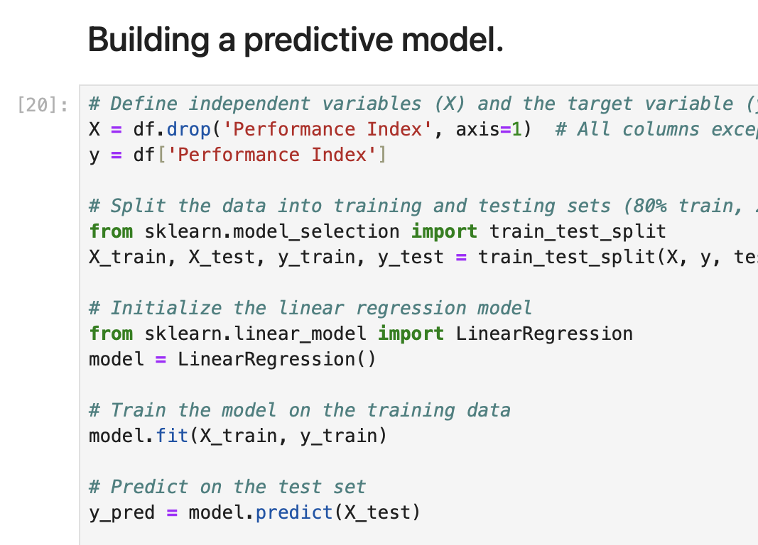
Model Building
Linear Regression Model:
Target Variable: Performance Index
Independent Variables: Hours Studied, Previous Scores, Extracurricular Activities, Sleep Hours, Sample Question Papers Practiced
Model Training: Data split into training (80%) and testing (20%) sets.

Slide 10
Model Evaluation
Performance Metrics:
Mean Squared Error (MSE): 4.3059
Root Mean Squared Error (RMSE): 2.0751
R-squared (R2): 0.9884
The model explains 98.84% of the variance in Performance Index.

Slide 11
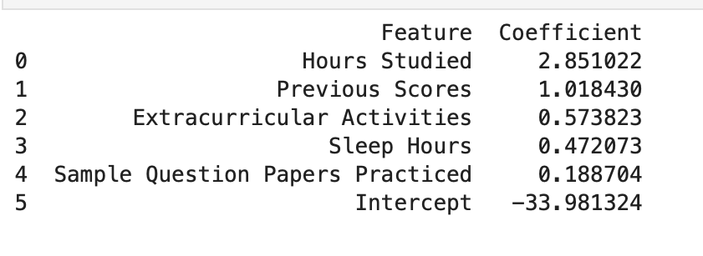
Model Coefficients
Interpretation of Coefficients:
Hours Studied: +2.85 points for each additional hour.
Previous Scores: +1.02 points for each additional point.
Extracurricular Activities: +0.57 points for each additional activity.
Sleep Hours: +0.47 points for each additional hour of sleep.
Sample Question Papers Practiced: +0.19 points for each additional paper.
Intercept: -33.9813 (when all variables are 0).

Slide 12
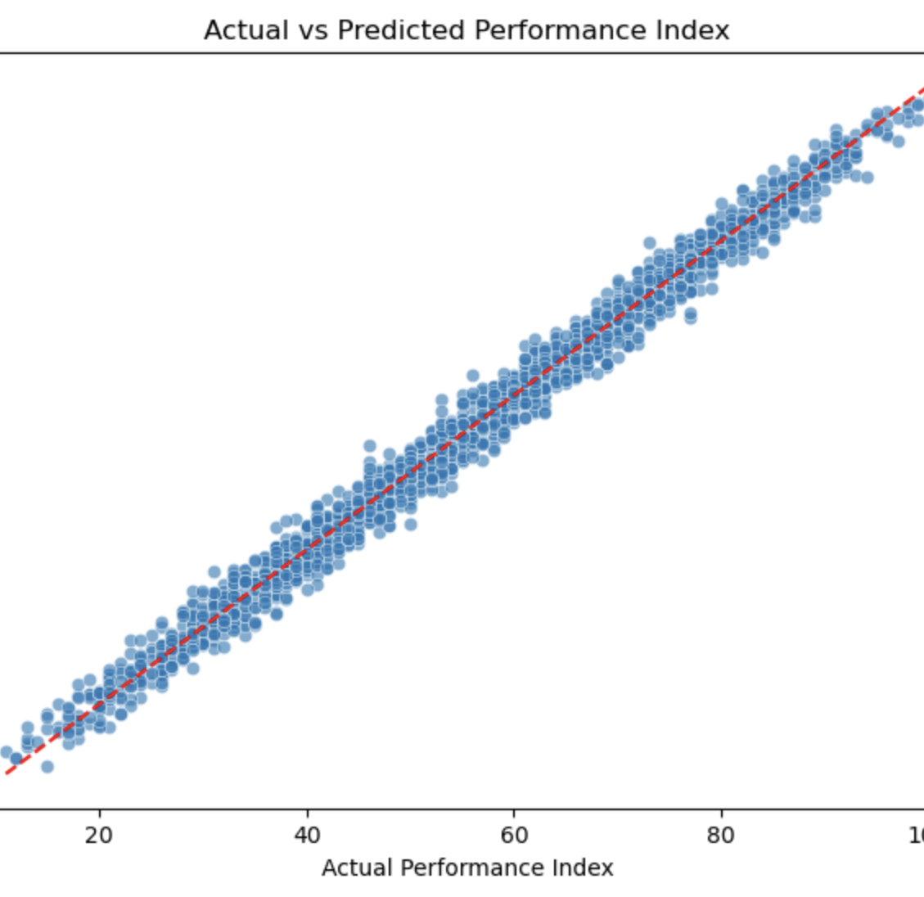
Actual vs Predicted Performance Index
Visualization: Scatter plot showing the relationship between actual and predicted performance index.
Interpretation: Points closely align with the diagonal line, indicating accurate predictions.

Slide 13
Conclusion
Key Findings:
Previous Scores and Hours Studied have a significant impact on student performance.
Extracurricular Activities, Sleep Hours, and Sample Question Papers Practiced have weak correlations.
Model Accuracy: The linear regression model provides highly accurate predictions (R2 = 0.9884).

